Slide 1
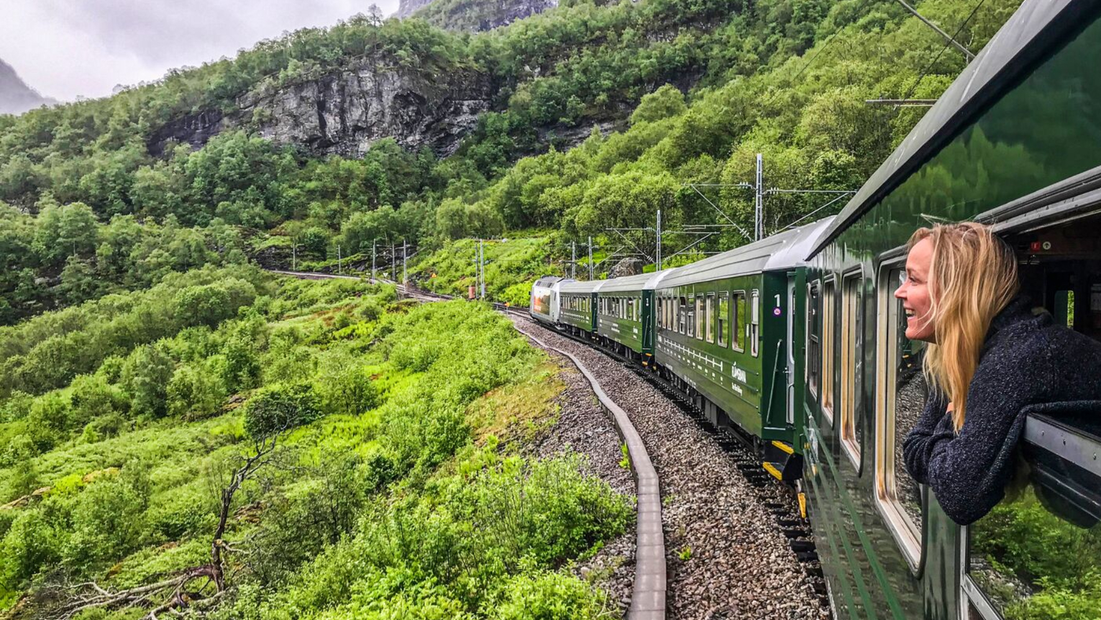
Digital Ticketing System

Slide 2
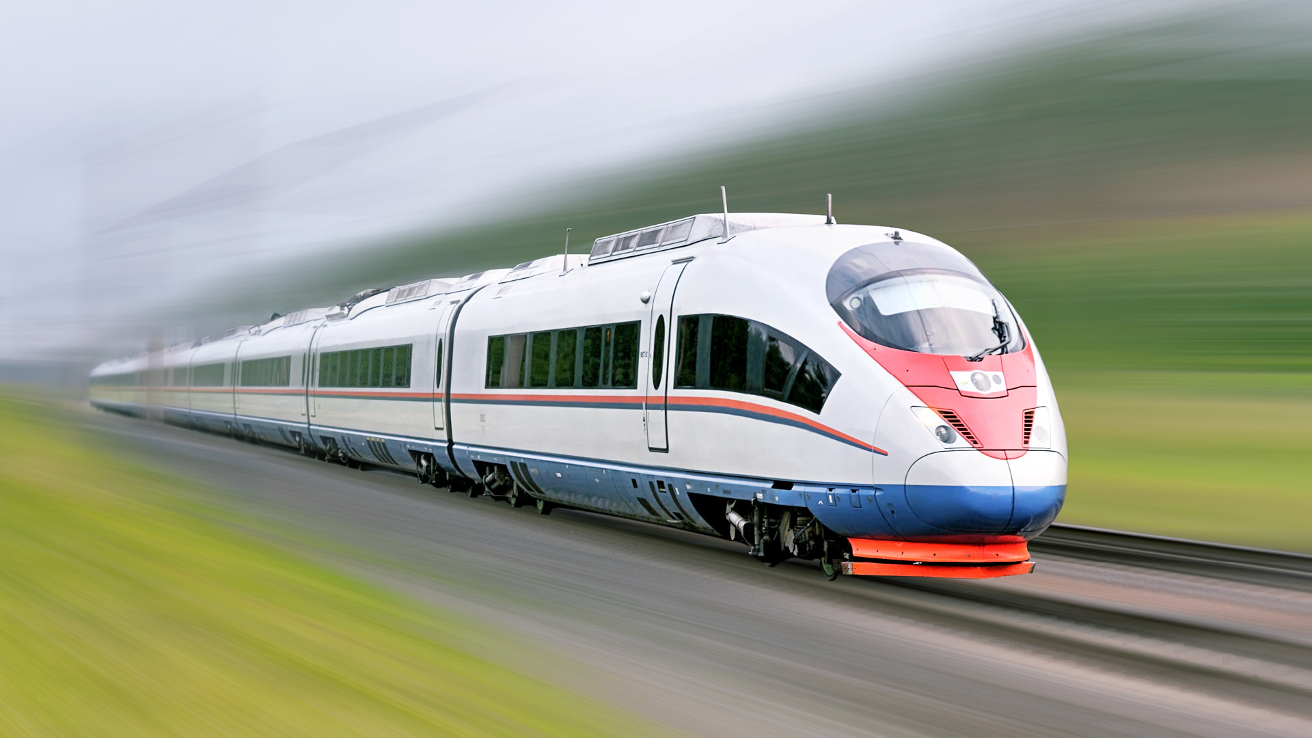
Made By :-
MUSTHAFFA SHAIK 1BI20CS112

Slide 3
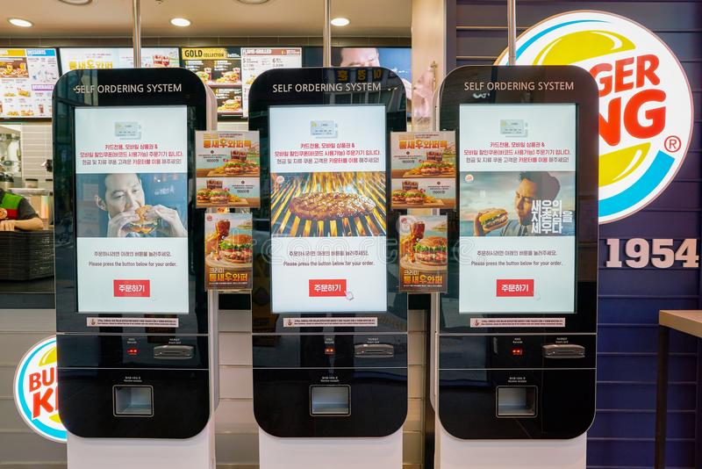
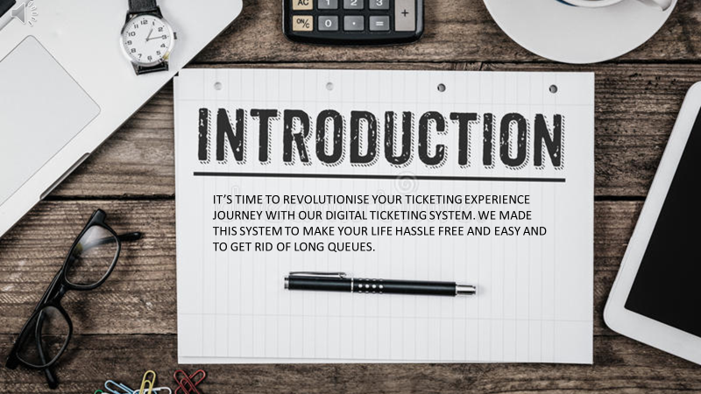
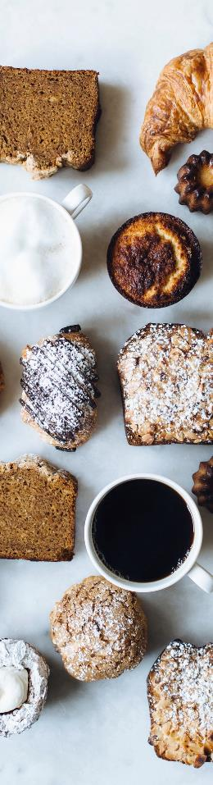

Introduction
The current system is paper based. Papers are used in restaurants for displaying the traditional menu cards, writing down the orders of customers, calculation of bills and taxes. The disadvantages of paper-based system are that papers can get easily damaged; they can be lost due to fire or accidents or can get lost in general. Hence, time and money is wasted
So, we have created a project named “Restaurant and Food Billing System”. This project is a basic program which can be used in restaurants. The main aim is to perform the process of billing and ordering of a “restaurant”.
This system is designed especially for a restaurant which wants to attend their customers in a very well manner. This system has the capability to display the bill, including the GST and other taxes to the customers.

Slide 4
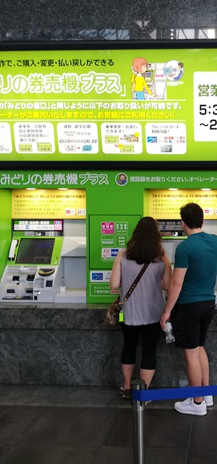
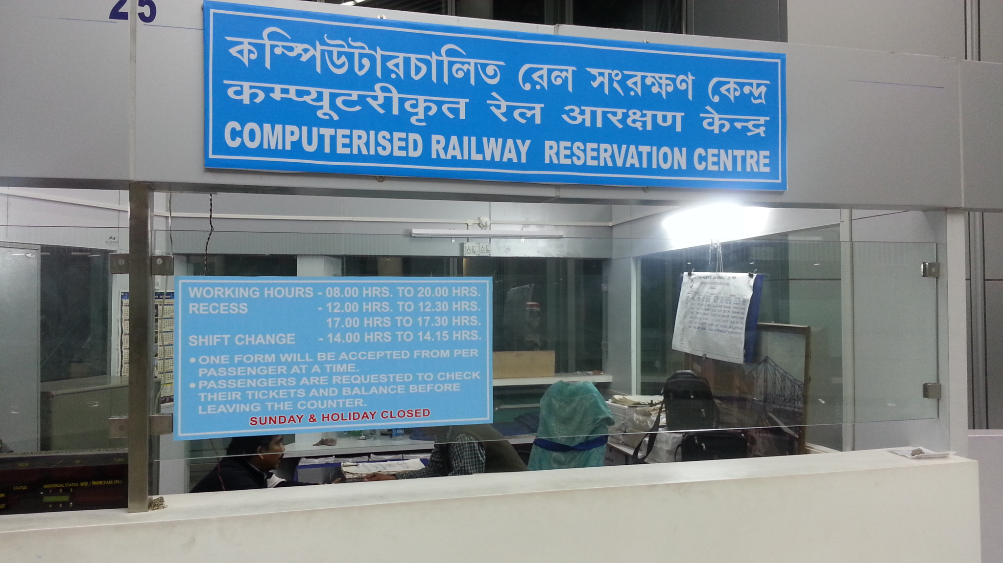
OBJECTIVES • To provide the customers with an easy and simple way of booking train tickets at a comfort of their homes. • To reduce the time, energy, and resources that was being consumed while performing a counter -based reservation .
• To generate a ticket that is valid throughout the journey . • To provide a convenient solution of billing pattern.

Slide 5
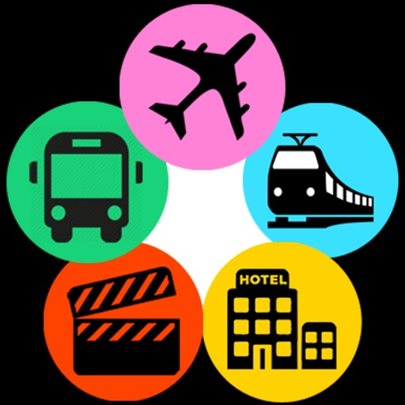
WORKING:- As we run the program, initially it displays the introduction of all the teammates and asks the user to enter the password. If you type the correct password ,then it moves further to the next part else it will ask the user to try again. The next part consists of three options -: 1st -new user 2nd -login 3^{rd -}exit. It will ask the user to enter 1 ,2 or 3.
If you choose Login , it will ask for username and if no existing user is found, it displays username notfound and returns to the beginning . So now you have to create a new user. To create a new user, Username, DOB, Phone Number and Password needs to be entered and it will store it in it’s database and make you
logged in with that account.

Slide 6
WORKING:- As soon as you login, it will ask for source and destination stations. In our program you have to be careful with your spellings, if you enter wrong spelling ,then it will ask you to enter a valid station. After this, it will ask for the date on which you wish to travel. After entering the date ,it will display a chart of available trains with their details
Then you have to enter the train number as per your convenience
,which is present in the chart. After that ,it will show you fare details. To continue booking , press 2 but if you wish to select another train press1. If you select 1 ,it will show the train chart again but, if you press 2 ,it will ask you for number of
passengers and their details.

Slide 7
WORKING:- Then you have to choose which Class you want to travel in. After this, you will receive an OTP on your registered mobile number. If you enter wrong OTP, it will ask you to try again else it will proceed further and show “your payment is successful” for which you have to add a payment gateway. Now, at this point your booking is complete
Your booking details will be displayed and the program
returns to the startingpoint where it
will ask you to create new user or login.
But now ,we already have a user ,so we can use login option with proper username and password .If you wish to exit, choose exit option and the program
will get terminated.

Slide 8
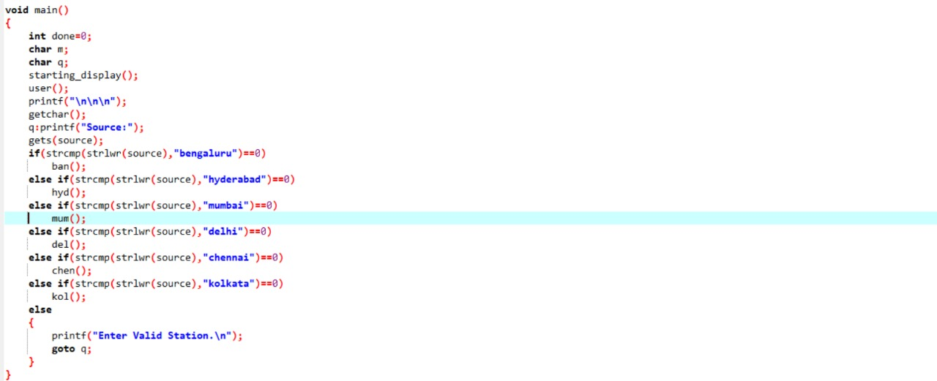
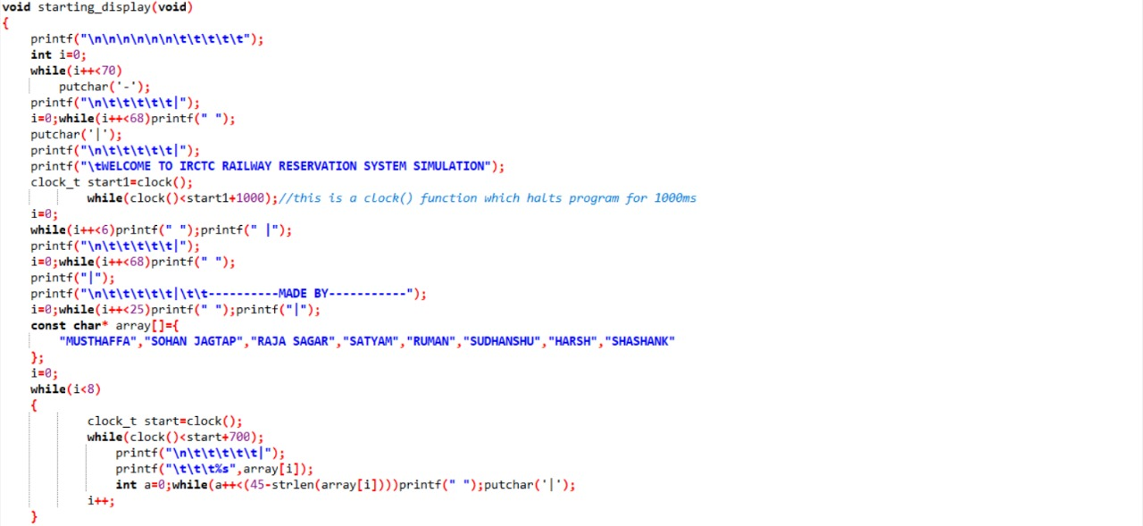
SOURCE CODE

Slide 9
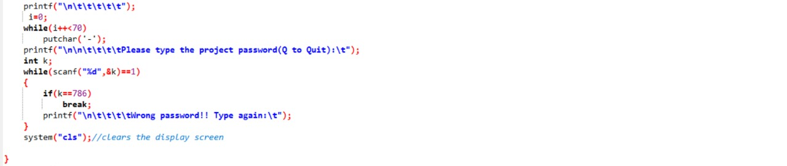
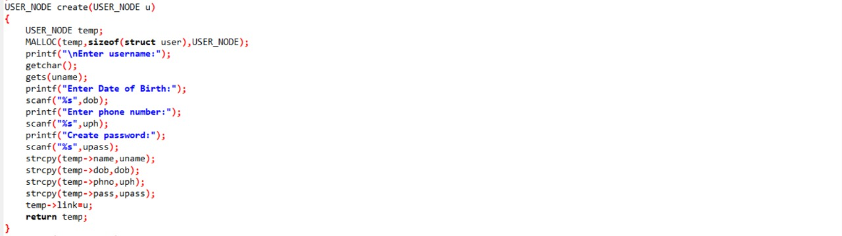
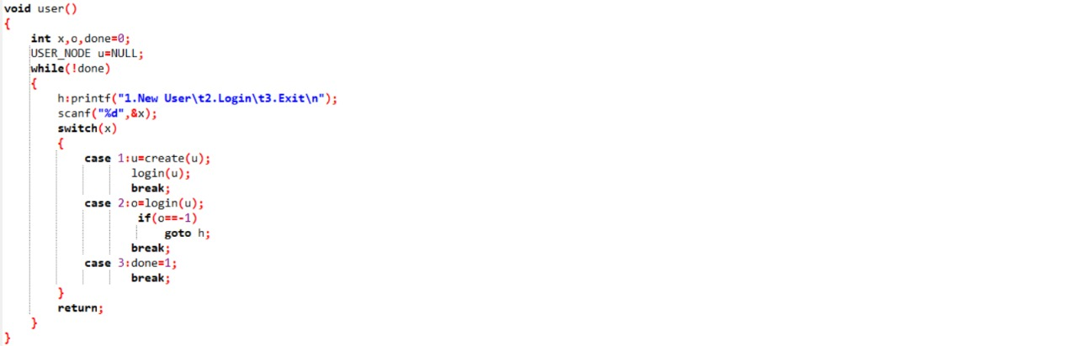

Slide 10
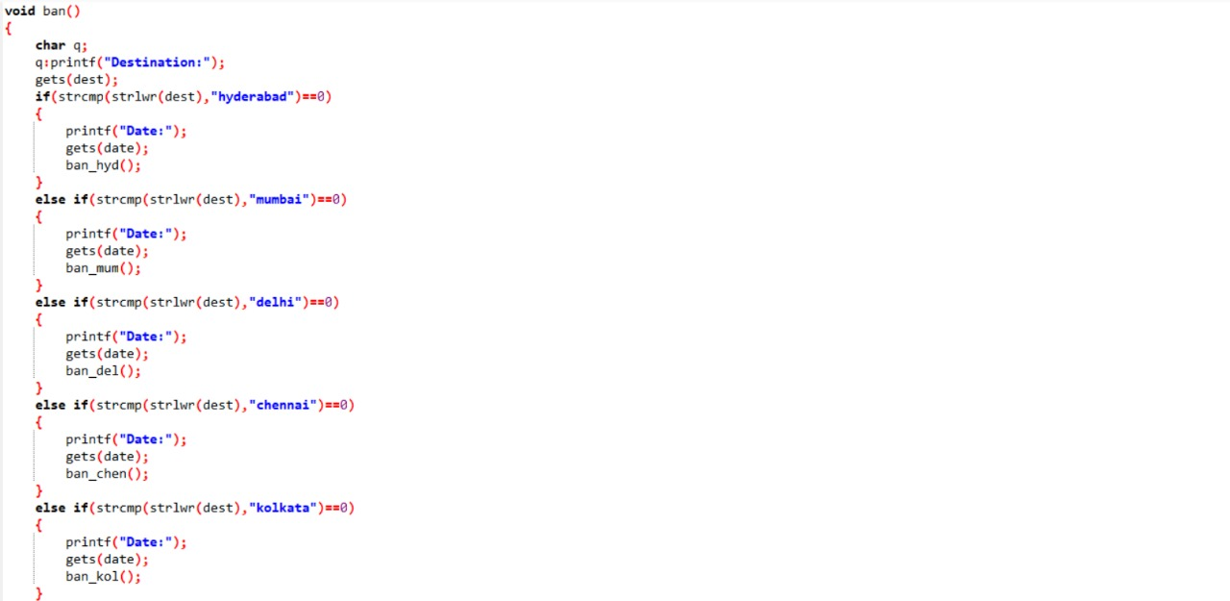
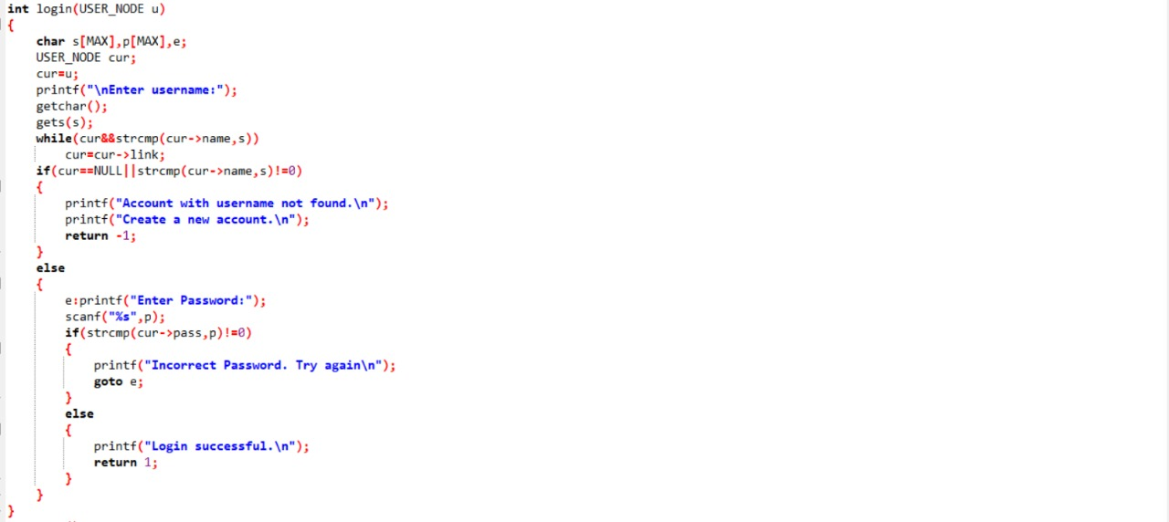

Slide 11
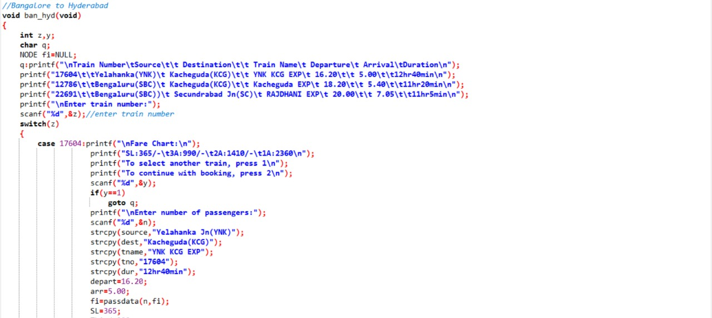
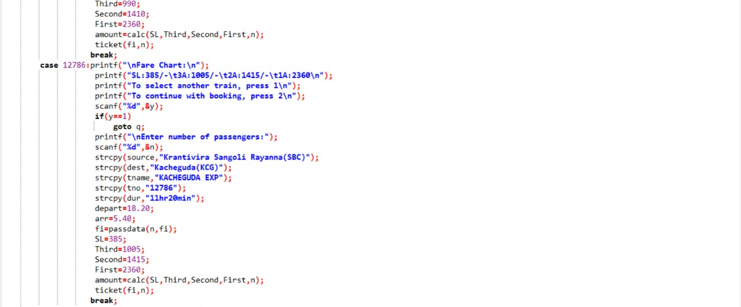

Slide 12
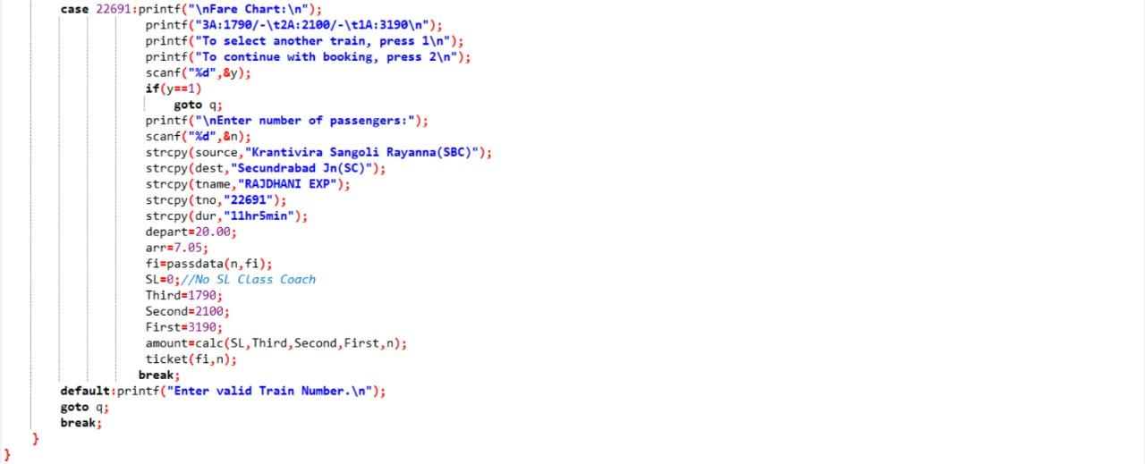
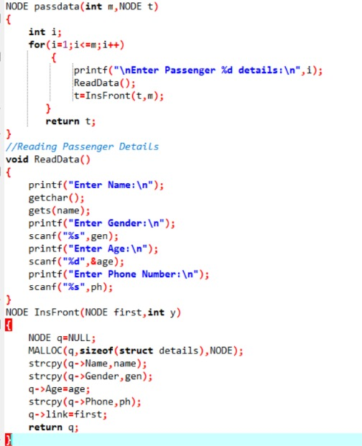

Slide 13
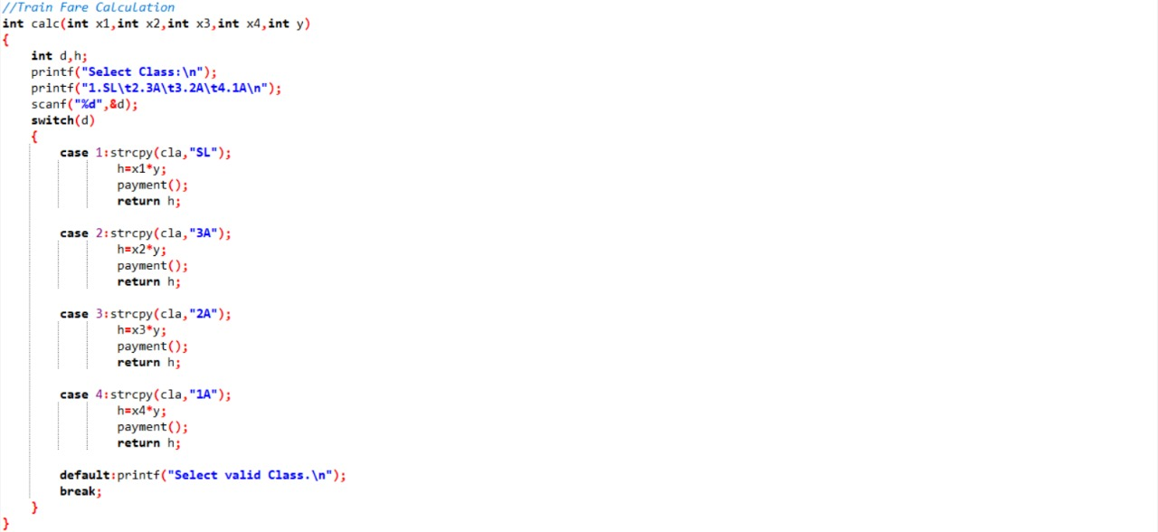
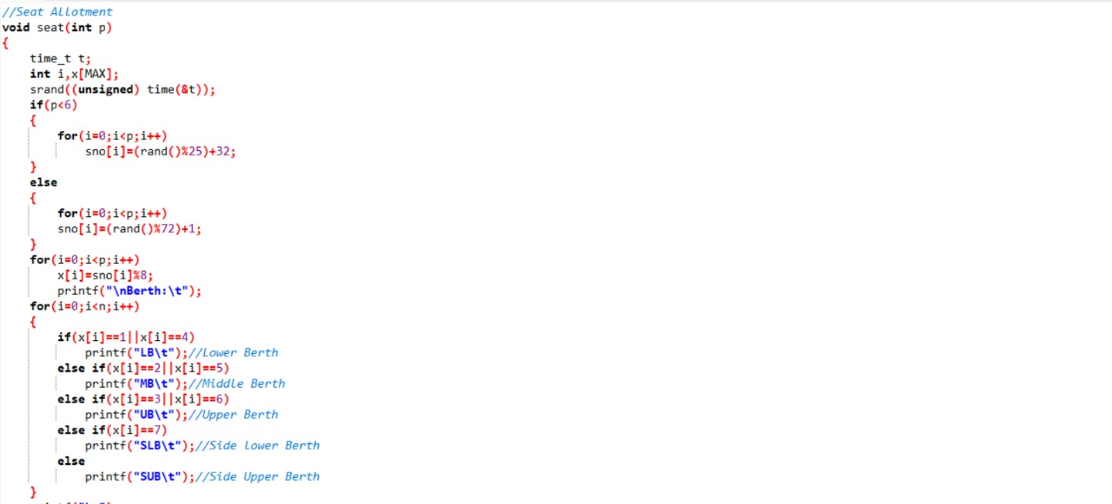
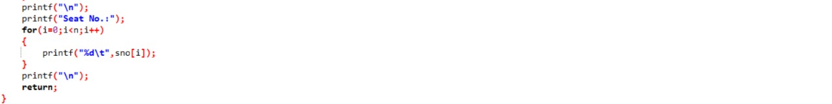

Slide 14
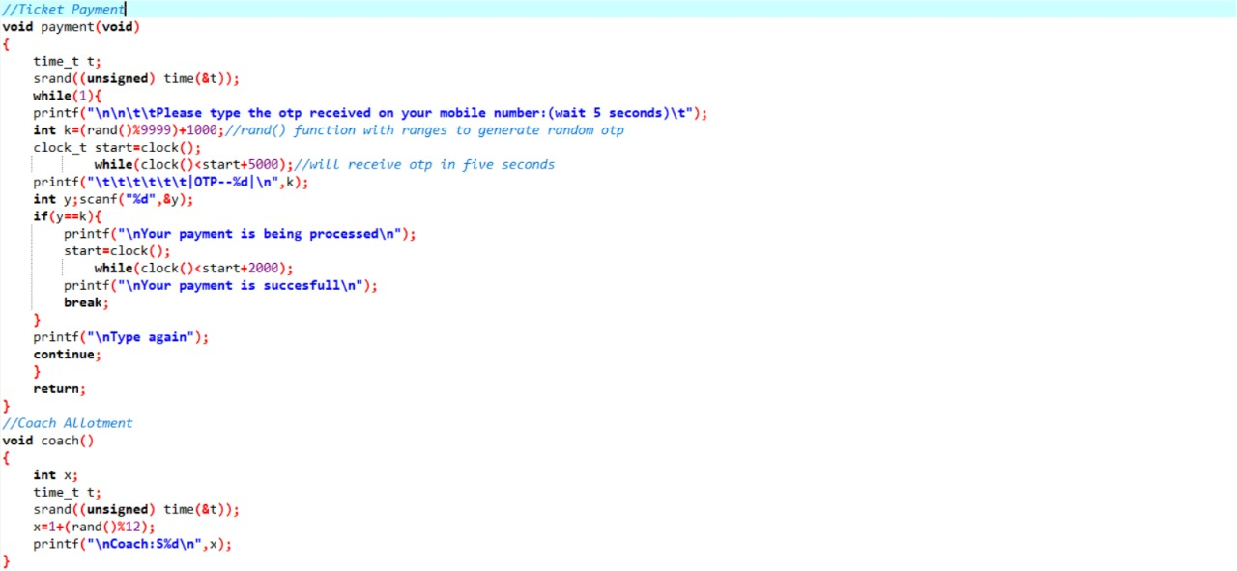
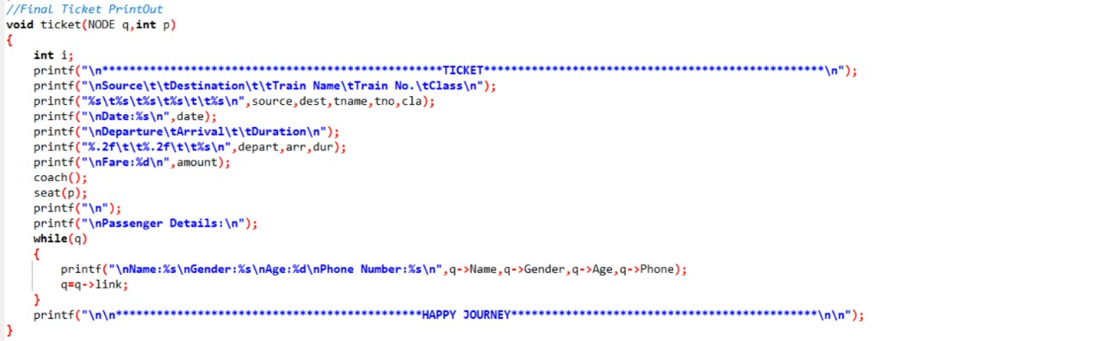

Slide 15
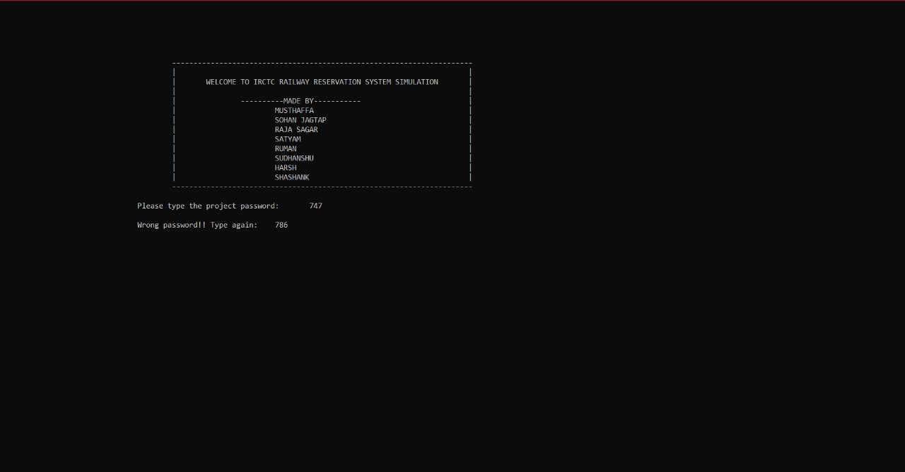
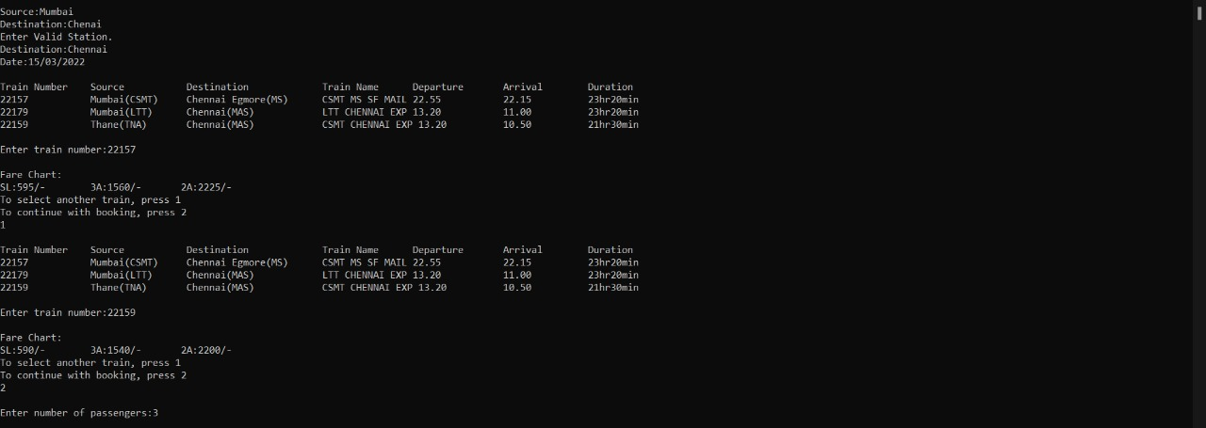
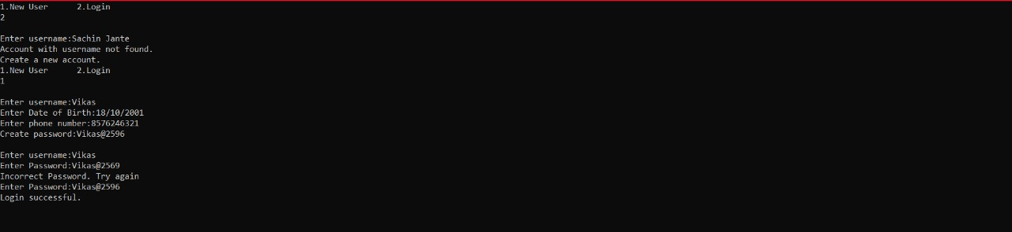
OUTPUT:-

Slide 16
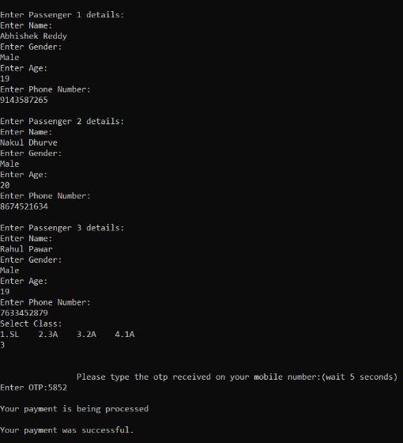
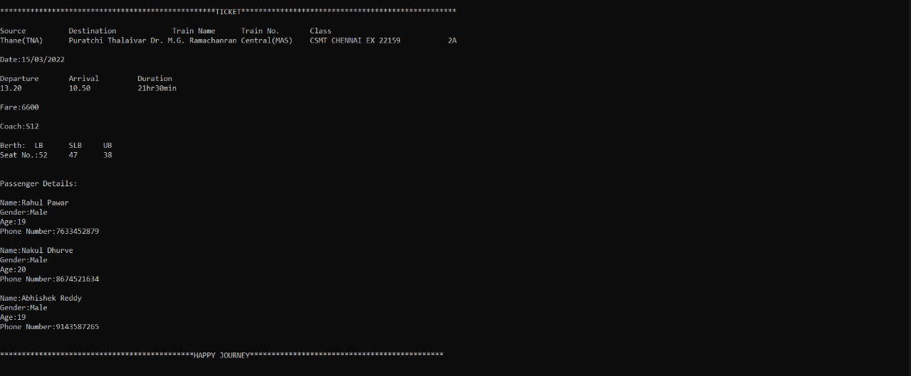
OUTPUT:-

Slide 17
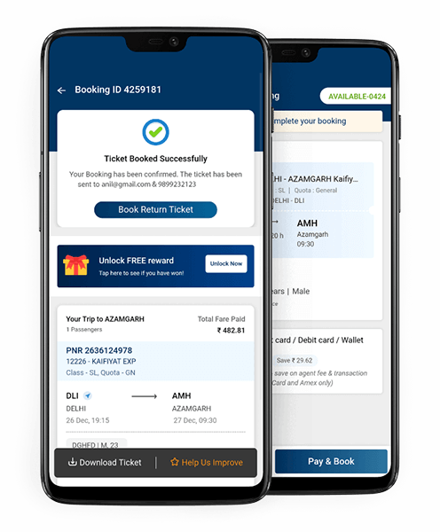
APPLICATIONS
A well designed and operated software can reduce processing time by great margins.
Easy to keep record of travel and passengers for business and analytical purposes.
No tension of Long Queues and it provides a Hassle Free user experience.
Ticket generated digitally is Environment Friendly as there is no wastage of Paper.
The ticket is Portable and safe to carry which reduces the chances of theft.
Software can be slightly modified to create airline, bus and even movie ticketing platforms.

Slide 18
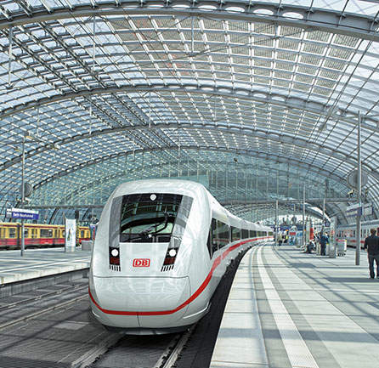
Thank You

